Slide 1

PLANNING IN SPORTS
WHAT IS PLANNING-
ACCORDING TO ALLEN, “PLANNING IS A TRAP LAID TO CAPTURE THE FUTURE”.
ACCORDING TO MITCHELL, “PLANNING IS USUALLY INTERPRETED AS A PROCESS TO DEVELOP A STrATeGY TO ACHIEVE DESIRED OBJECTIVES, TO SOLVE PROBLEMS AND TO FACILITATE ACTION”
MEANING OF PLANNING
PLANNING IS THE PROCESS WHICH HELPS US IN REACHING OUR GOAL EFFICENTLY AND SMOOTHLY
A PLAN IS A PREDETERMINED COURSE OF ACTION TO ACHIEVE A SPECIFIC GOAL

Slide 2
OBJECTIVES OF PLANNING ARE AS FOLLOWS:
1. TO CREATE GOOD COORDINATION,
2. TO KEEP GOOD CONTROL,
3. TO REDUCE UNNECESSARY PRESSURE OF IMMEDIACY,
4. TO MINIMIZE THE CHANCES OF MISTAKE,
5. TO AVOID WASTAGE OF MONEY, TIME & RESOURCES,
6. TO UTILIZE THE RESOURCES EFFECTIVELY AND ECONOMICALLY,
7. TO IMPROVE THE EFFECTIVENESS OF THE ORGANIZATION.

Slide 3
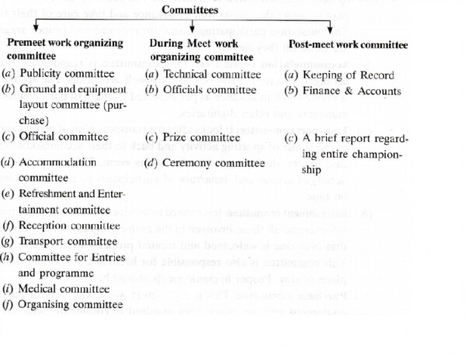
VARIOUS COMMITTEES TO ORGANISE A TOURNAMENT

Slide 4
TOURNAMENT
A SERIES OF SPORTS COMPETITIONS, IN WHICH, A TEAM FINALLY WINS AND REST OF THE PARTICIPATING TEAMS LOSE THE MATCHES. IT DEPENDS ON VARIOUS FACTORS I.E. - NO. OF PARTICIPATING TEAMS, AVAILABILITY OF GROUND AND EQUIPMENT , NO. OF DAYS AND FUNDS.
IMPORTANCE OF TOURNAMENT
DEVELPOMENT Of SPORTS SKILLS
PROPAGANDA OF SPORTS
HELPFUL IN SELECTION OF PLAYERS
DEVELOPMENT OF NATIONAL AND INTERNATIONAL INTEGRATION
DEVELOPMENT OF SOCIAL QUALITIES
SOURCE OF RECREATION

Slide 5
Types of Tournament
A. Knock out : In this type of tournament, the team once defeated, gets eliminated from the tournament. Only the winning teams contest in the next rounds. Opportunities are given to the winning players/ teams.
B. League : In single league tournament all participating teams compete, with each other,where-as in double league, each team plays with every other team twice, without any consideration of victory or defeat.
C. Combination Tournament: These are the Tournament is which some rounds are played on the basis of knock out & some are played on the Basis of league examples.
Knock out cum knock out
Knock out cum league
League cum league
League cum knock out
D. Challenge Tournament

Slide 6
ADVANTAGES OF KNOCK OUT TOURNAMENT
LESS EXPENSIVE
TAKES LESS TIME TO COMPLETE
ENHANCES THE STANDARD OF SPORTS
MINIMUM NUMBER OF OFFICIALS ARE REQUIRED

Slide 7
DISADVANTAGES OF KNOCKOUT TOURNAMENT
MANY CHANCES OF ELIMINATION OF GOOD TEAMS
WEAK TEAMS MAY ENTER THE FINALS
SPECTATORS MAY LOOSE INTEREST IN THE TOURNAMENT

Slide 8
ADVATAGES OF LEAGUE TOURNAMENTS
EVERY TEAM GETS MAXIMUM OPPERTUNITIESTO SHOW THEIR TALENT
ONLY STRONG DESERVING TEAMS GETS VICTORY
INCREASES THE POPULARITY OF SPORTS
PLAYERS GET OPPERTUNITIES TO IMPROVE SKILLS

Slide 9
DISADVANTAGES OF LEAGUE TOURNAMENT
IT REQUIRES MORE TIME
IT COSTS MORE
MORAL OF THE TEAMS BECOMES LOW DUE TO CONTINUOUS DEFEAT
SPECTATORS LOOSE INTEREST

Slide 10
ASSIGNMENT NO. 1
Marks: 10 (5x2)
Enlist the committees for organizing sports day in your school. Explain about any three such committees in detail
Differentiate between league and knock-out tournaments

